Slide 1
Sentimental Analysis of Amazon Book Reviews ( R, Machine Learning )
- VENKATESH SEKAR

Slide 2
Understanding buyer’s perception
Western Digital and Amazon wants to understand how WD Blue 1TB SATA drive is performing in the market. They want to understand the buyer’s opinion to improve the product quality, Amazon services and process.
The buyer’s reviews are the best source of information to analyse how the product stands in the market
Large number of reviews and text contents are difficult to analysed manually.
Sentiment analysis and Machine algorithms are handy tools to analyse such reviews using Text analysis.
Product Analysed
https://www.amazon.com/Blue-Cache-Desktop-Drive-WD10EZEX/dp/B0088PUEPK/ref=cm_cr_arp_d_product_top?ie=UTF8

Slide 3
What is Sentimental Analysis
The process of computationally identifying and categorizing opinions expressed in a piece of text, especially in order to determine whether the writer's attitude towards a particular topic, product, etc., is positive, negative, or neutral.
As language evolves, the dictionary that machines use to comprehend sentiment will continue to expand.
We employ a rules-based process to help our software better understand the ways context can affect sentiment.
Eg “I want a burrito so bad”
“I just had a burrito. It was so bad.”

Slide 4

Source of Data
We scraped the reviews from Amazon website for this product using rvest library in R
Created Document-Term matrix from scraped reviews.
By definition:Document-Term matrix is a mathematical matrix that describes the frequency of terms that occur in a collection of documents
For instance if one has the following two (short) documents:
D1 = "I like databases“
D2 = "I hate databases", then the document-term matrix would be:

Slide 5
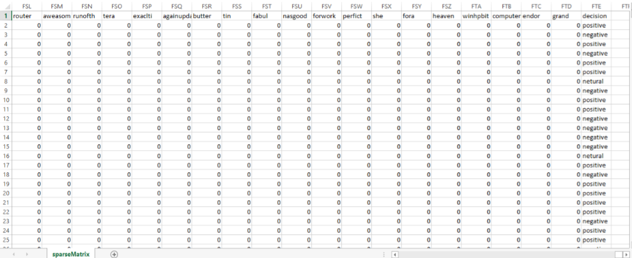
Reviews Sparse Matrix
The columns consists of unique words from all reviews
The rows are the reviews.
Each cell represents the count of that column (word) in the row (review)

Slide 6
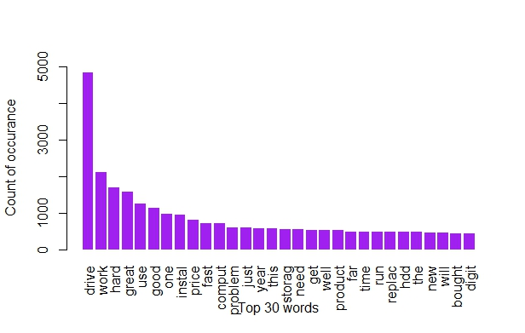
Most frequent words (w/o considering its significance in Sentiment Analysis)
Words such as ‘drive’, ‘one’, ‘just’, ‘get’, ‘this’ and few more doesn’t contribute towards sentiment analysis.

Slide 7
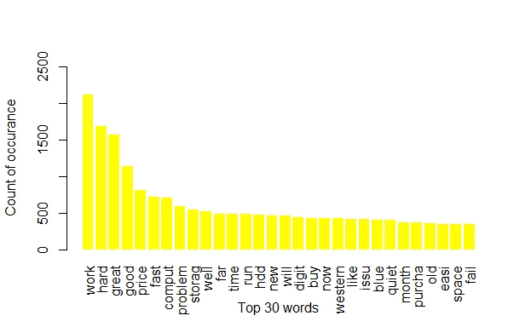
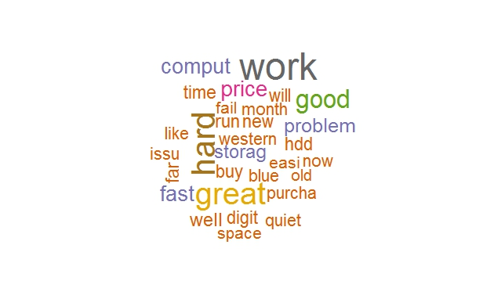
Most frequent words (considering its significance in Sentiment Analysis)

Slide 8
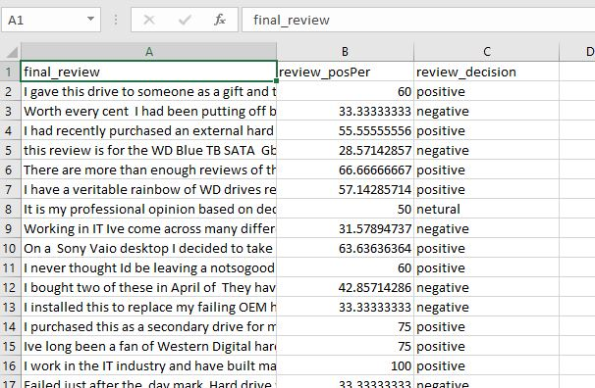
Reviews with Sentiment Analysis output

Slide 9
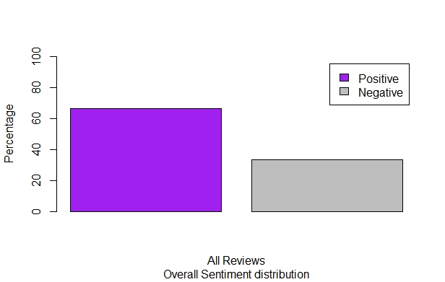
Sentiment percentage distribution for all reviews

Slide 10
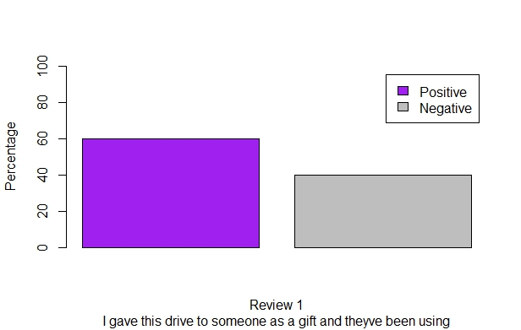
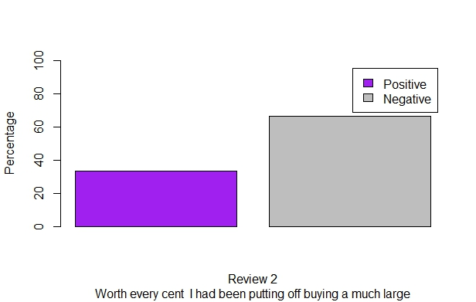
Sentiment Percentage for two reviews

Slide 11
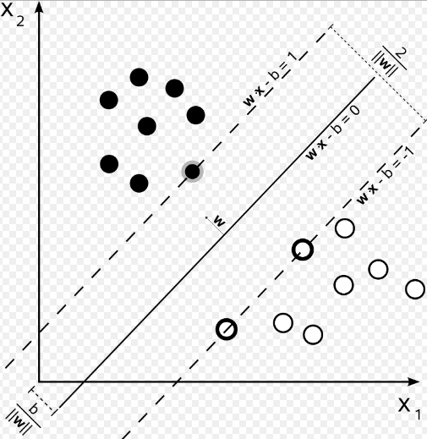
Support Vector Machine
If the training data are linearly separable, we can select two parallel hyperplanes that separate the two classes of data, so that the distance between them is as large as possible. The region bounded by these two hyperplanes is called the "margin", and the maximum-margin hyperplane is the hyperplane that lies halfway between them.
Samples on the margin are called the
support vectors.

Slide 12
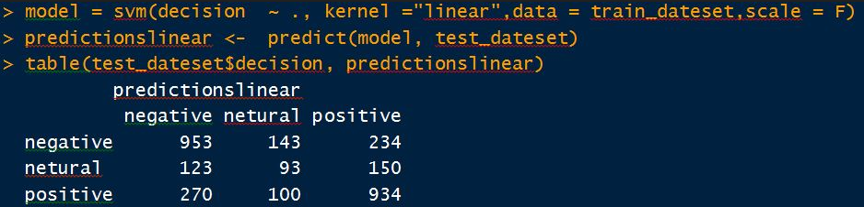
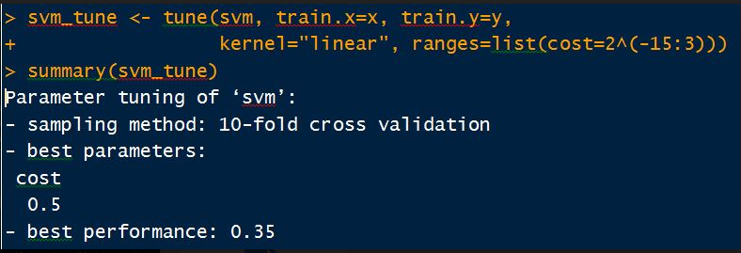
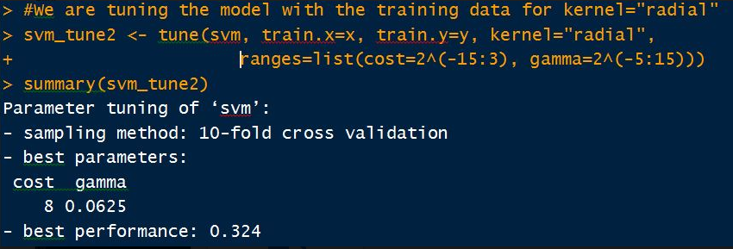
The basic data without Tuning
Tuning using Linear Kernel. Performance is 0.35
Tuning using Radial Kernel. Performance is 0.324

Slide 13
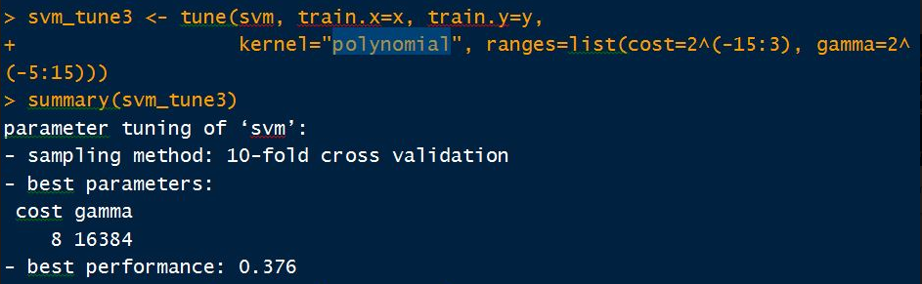
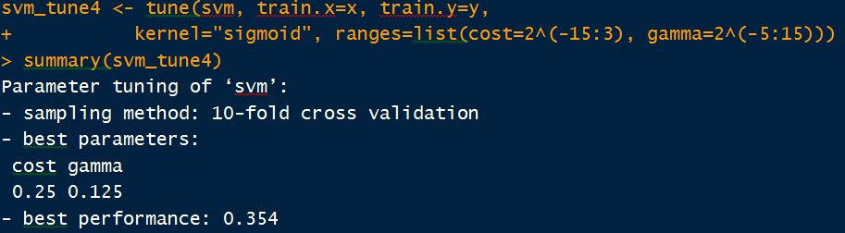
Tuning using Polynomial Kernel. Performance is 0.376
Tuning using Sigmoid Kernel. Performance is 0.354

Slide 14
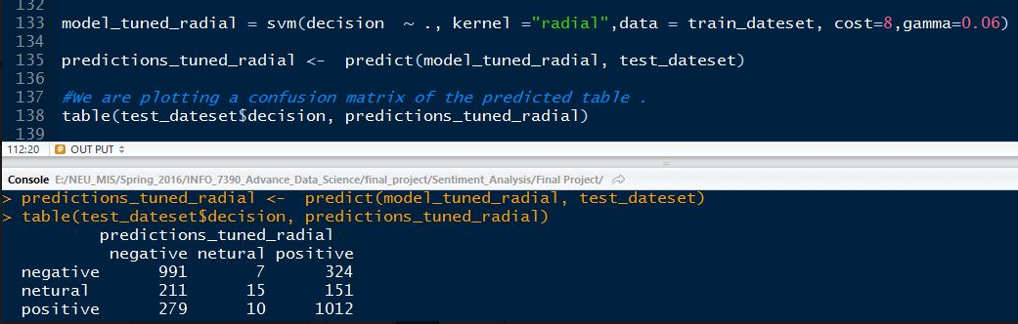
So the best result is obtained via Radial Kernel

Slide 15
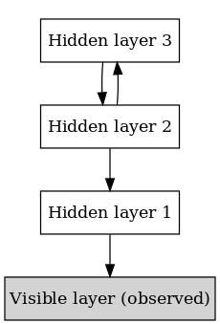
Deep Belief Networks
A deep belief network (DBN) is a probabilistic, generative model made up of multiple layers of hidden units
A DBN can be efficiently trained in an unsupervised, layer-by-layer manner

Slide 16
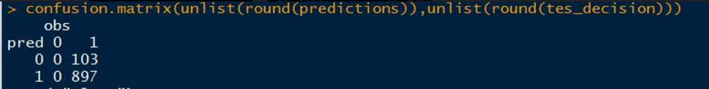

Slide 17
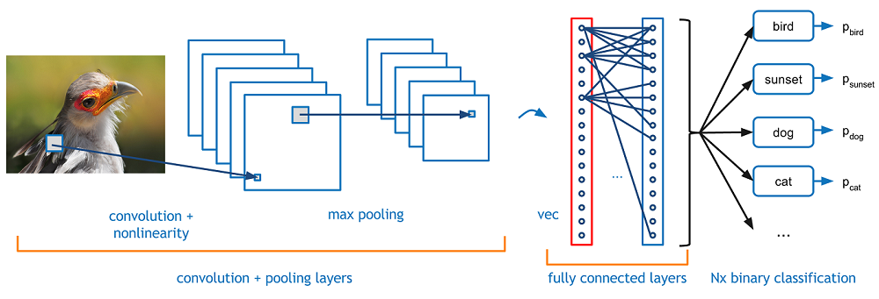
Convolutional neural network
A Convolutional Neural Network (CNN) is comprised of one or more convolutional layers (often with a subsampling step) and then followed by one or more fully connected layers.

Slide 18
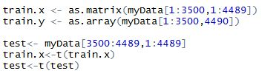
How to get data?
A matrix is a collection of data elements arranged in a two-dimensional rectangular layout. Our matrix is formed with 3500 rows and 4489 columns
Columns are expected to be squared number.
We had to add dummy variables for that. (Thanks to out TA for this guidance)

Slide 19

How to make model in CNN
library(mxnet) and library(deepnet) are required for CNN.
The first layer in a CNN is always a Convolutional Layer.
There are several parameters we have to feed to
Training data and label.
Number of hidden nodes in each hidden layers.
Number of nodes in the output layer
Learning rate is required to be less to reduce overfitting of data.
Type of the output loss.
The device to train (GPU or CPU).

Slide 20
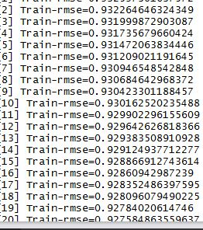
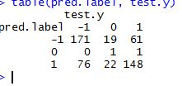
Output

Slide 21
That’s All Folks…….
THANK YOU

